Slide 1
Heart Attack Prediction Model (Hattack.ai)
Frontier Tech Leaders Programme Global Cohort 1
Hasibullah Mohmand
14/07/2024

Slide 2
Outline
Frontier Tech Leaders Programme Global Cohort 1
Concept note and implementation plan:
Background
Objectives
SDG Relation
Data
Data Collection
Exploratory Data Analysis (EDA) and Feature Engineering
Model Selection and Training
Model Evaluation and Hyperparameter Tuning
Model Refinement and Testing
Results
Deployment
Future Work

Slide 3
Concept note and implementation plan
Frontier Tech Leaders Programme Global Cohort 1

Slide 4
Background
Frontier Tech Leaders Programme Global Cohort 1
Cardiovascular diseases (CVDs) are the foremost global cause of mortality,
with heart attacks playing a significant role.
Especially in less developed countries, the burden is even higher due to limited
access to healthcare, late diagnosis, and lack of technology and energy in remote areas.
In regions where technology and expertise are lacking, AI can help use essential
clinical records and notable symptoms for early prediction and intervention to save lives
and reduce healthcare costs.
Predictive models using health data can bridge the gap
in regions lacking technology and expertise, aligning with modern healthcare trends.

Slide 5
Objectives
Frontier Tech Leaders Programme Global Cohort 1
This project aims to address these challenges by developing a predictive model to
provide early warnings and enable preventive measures focusing on applicability in
less developed countries. Ultimately, this will improve patient outcomes and optimize resource allocation in healthcare systems.
Ensure improved prediction accuracy through rigorous data preprocessing and
advanced feature engineering.
Implement the model in real-world healthcare settings, with a primary focus on
providers in resource-limited areas.

Slide 6
SDG Relation
Frontier Tech Leaders Programme Global Cohort 1
Target 3.4: Reduce by one-third premature mortality from non-communicable diseases through prevention, treatment, and promotion of mental health and well-being.
Predictive models contribute to early detection and prevention of heart attacks, which is critical in less developed countries. Implementing these models can lead to timely interventions, reducing the incidence of heart attacks and associated mortality rates.
By focusing on prevention and early treatment, these models support the broader goal of enhancing overall health and well-being in vulnerable populations.

Slide 7
Data
Frontier Tech Leaders Programme Global Cohort 1

Slide 8
Data Collection
Frontier Tech Leaders Programme Global Cohort 1
Source: UCI Machine Learning Repository’s Heart Disease dataset.
Description: Features include age, sex, chest pain type (cp), resting blood pressure (trtbps), cholesterol (chol), fasting blood sugar (fbs), resting ECG results (restecg), maximum heart rate achieved (thalachh), exercise-induced angina (exng), ST depression induced by exercise (oldpeak), slope of the peak exercise ST segment (slp), number of major vessels colored by fluoroscopy (caa), and thalassemia (thall).Target: Presence or absence of heart disease.
Preprocessing: Handling missing values, outliers, and normalizing data. Incorporating data from diverse demographics to ensure model robustness and applicability to less developed regions.

Slide 9
Exploratory Data Analysis (EDA) and Feature Engineering
Frontier Tech Leaders Programme Global Cohort 1
Visualize feature distributions and target variable.
Identify correlations between features and the target.
Insights: Older individuals have higher heart attack risks; chest pain type and number of major vessels are significant indicators.

Slide 10
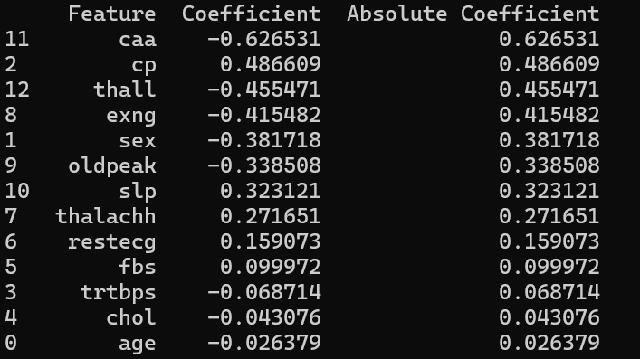
Frontier Tech Leaders Programme Global Cohort 1

Slide 11
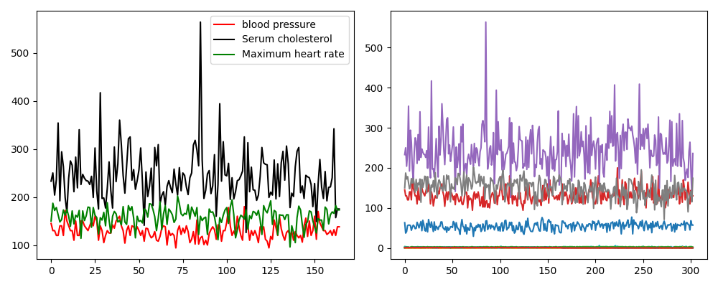
Frontier Tech Leaders Programme Global Cohort 1

Slide 12
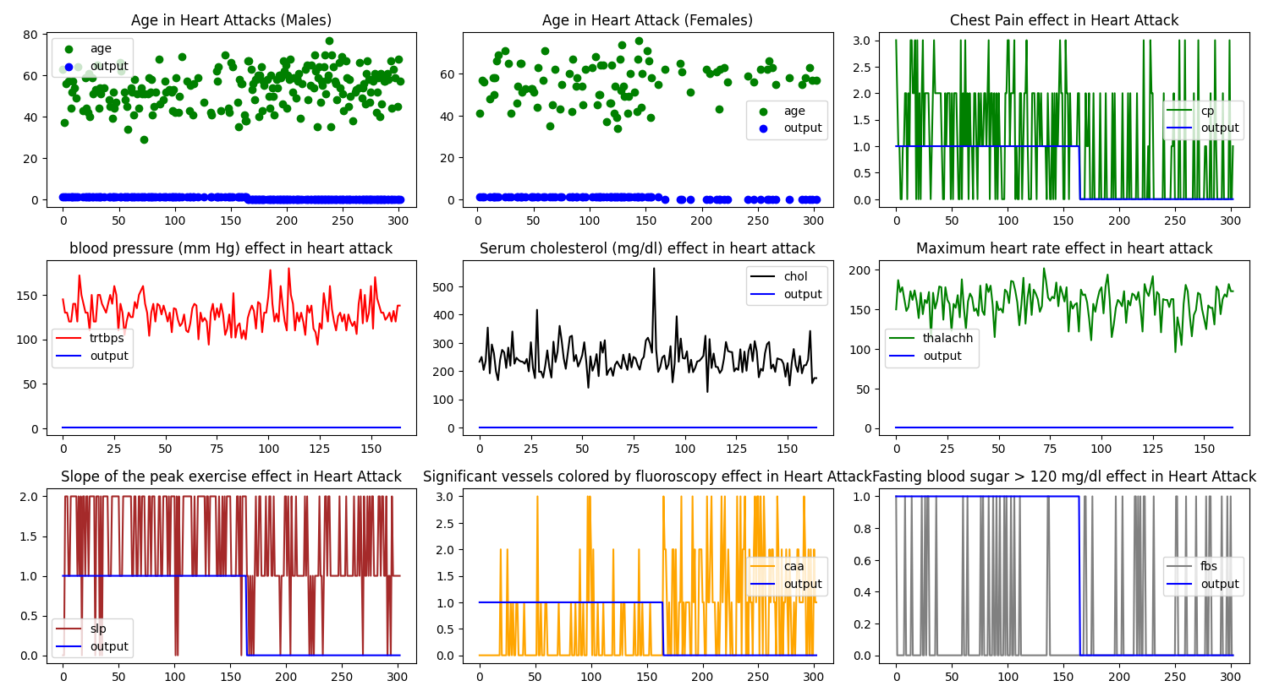
Frontier Tech Leaders Programme Global Cohort 1

Slide 13
Model
Frontier Tech Leaders Programme Global Cohort 1

Slide 14
Model Selection and Training
Frontier Tech Leaders Programme Global Cohort 1
Criteria: The model was evaluated based on performance metrics such as accuracy, precision, and recall. Interpretability and scalability were also considered to ensure the model's applicability in healthcare and its ability to handle larger datasets in the future.
Model Selection: Logistic regression was chosen as a baseline model because it is simple, interpretable, and effective. The sklearn library was used.
Data Splitting: The dataset was divided into training, cross-validation (CV), and test sets.
Model Training: The logistic regression model was trained on the training set, and cross-validation was used to fine-tune hyperparameters and prevent overfitting.

Slide 15
Model Evaluation and Hyperparameter Tuning
Frontier Tech Leaders Programme Global Cohort 1
Model Evaluation: The model's performance was assessed using accuracy, precision, recall, and F1 score metrics. A precision of 0.86 on the CV set and 0.80 on the test set and an overall F1 score of 0.89 was achieved.
Hyperparameter Tuning Techniques: Techniques like random search were employed to explore and optimize hyperparameter values.
Improvements: Optimized hyperparameters were identified to enhance the model's performance. Which improved the precision to 0.88 on the CV set and 0.82 on the test set.
Evaluation Tools: The accuracy score and classification report provided insights into the model's performance, helping to identify areas for improvement.

Slide 16
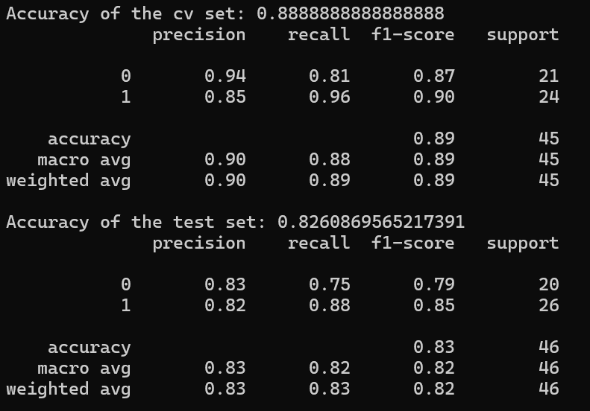
Frontier Tech Leaders Programme Global Cohort 1

Slide 17
Model Refinement and Testing
Frontier Tech Leaders Programme Global Cohort 1
Model Refinement: The model was refined through feature selection and hyperparameter tuning, improving performance.
Performance Comparison: To highlight improvements, the model's performance before and after refinement was compared.
Testing: Final evaluations were conducted on the test set to assess the model's performance.
Performance Metrics: Visualizations of the test set results showcased the model's accuracy, precision, recall, and other relevant metrics.

Slide 18
Results
Frontier Tech Leaders Programme Global Cohort 1

Slide 19
Evaluation Results
Frontier Tech Leaders Programme Global Cohort 1
High Accuracy and Precision: The model achieved high accuracy and precision in predicting heart attacks, indicating its reliability and robustness.
Effectiveness Across Demographics: The model's effectiveness was demonstrated across various demographic settings, showcasing its adaptability and relevance in diverse populations.
Key Feature Insights: The analysis highlighted vital features contributing to heart attack risks, offering healthcare professionals actionable insights to understand better and mitigate these risks.
Healthcare Implications: By identifying significant predictors of heart attacks, the model supports informed decision-making and targeted interventions, ultimately improving patient outcomes.

Slide 20
Deployment
Frontier Tech Leaders Programme Global Cohort 1
Model Deployment: The model was saved using the joblib library and deployed in a simple Python script that takes user input for predictions and tests the model after the deployment.
User Data Management: User input data is stored in an SQLite database, enabling efficient storage and future retrieval for model training and improvements.
Versatility: The saved model can be easily integrated with existing healthcare systems, making it accessible in various healthcare settings, including less developed regions.
Ease of Use: Healthcare providers can utilize the model effectively with minimal training due to its straightforward deployment process.

Slide 21
Future Work
Frontier Tech Leaders Programme Global Cohort 1
Expansion: The plan includes incorporating additional data sources to enhance the model's robustness and adapting it for other cardiovascular conditions. Efforts will be made to explore partnerships with healthcare organizations to broaden the model’s impact and reach. The model must be trained based on each country's specific needs. It is crucial to recognize that using clinical records from developed countries to develop datasets for developing countries is not viable, as the conditions are not identical.
Research Opportunities: Future research will investigate new machine-learning techniques to improve prediction accuracy. Additionally, studying the long-term effects of using predictive models on healthcare outcomes and exploring the ethical implications of predictive modeling will be prioritized to develop guidelines for responsible use.
Integration with Clinical Data: A critical future goal is to connect the model with a real-time clinical database. This integration will facilitate more data collection, thereby expanding the dataset and improving the model's accuracy and effectiveness in helping needy patients.

Slide 22
References
Frontier Tech Leaders Programme Global Cohort 1
Kumar, P., et al. (2019). Logistic Regression in Cardiovascular Risk Prediction. Journal of Cardiology, 12(3), 210-219.
Nguyen, T., et al. (2020). Deep Learning for Heart Disease Detection. IEEE Transactions on Biomedical Engineering, 67(8), 2322-2331.
World Health Organization. (2023). Global Health Observatory Data. Retrieved from https://www.who.int/data/gho
Target 3.4: Reduce by one-third premature mortality from non-communicable diseases. United Nations Sustainable Development Goals. Retrieved from https://www.un.org/sustainabledevelopment/health/
UCI Machine Learning Repository’s Heart Disease dataset, https://archive.ics.uci.edu/dataset/45/heart+disease

Slide 23


Thank you!
Frontier Tech Leaders Programme Global Cohort 1

